Slide 1
AUTOMATED DRILLING ROBOT -DRILLERBOT-
PROJECT COORDINATOR :
PROF. ARUNIMA C V
AFSALKHAN C A
ROLL NO : 01
MINI PROJECT ( 222PEC100 )

Slide 2
INTRODUCTION
Automated drilling robot is a system designed to perform drilling operations with minimal human intervention.
Utilizes a Cartesian (rectangular) robotic system for precise and repeatable drilling.
Improves efficiency, accuracy, and automation in industrial applications.

Slide 3
OBJECTIVE
Develop an automated drilling system for precision and efficiency.
Minimize human intervention by using a robotic control system.
Implement Cartesian robot movement for accurate positioning.
Simulate and optimize using MATLAB and AutoDesk Fusion.
Improve production speed and quality in drilling applications.

Slide 4
APPLICATION
CNC machining and manufacturing.
PCB drilling in electronics production.
Aerospace and automotive component manufacturing.
Woodworking and metal fabrication.

Slide 5
WORKFLOW / TASKS
Identify the task – Aluminum fabrication
Workspace dimensions – 325mm x 400mm x 200mm (xyz)
Design in Fusion 360 – Create the 3D model and assembly.
Simulate in MATLAB – Test movement and performance in simulation.
Control implementation – Integrate stepper motors and control logic.
Testing & optimization – Evaluate performance and improve efficiency.

Slide 6
SYSTEM OVERVIEW
Mechanical Structure: Cartesian (gantry) robot with XYZ movement.
Actuation: NEMA 23 stepper motors for precise motion control.
Control System: MATLAB for simulation and control.
Drilling Mechanism: Spindle motor for high-speed drilling..

Slide 7
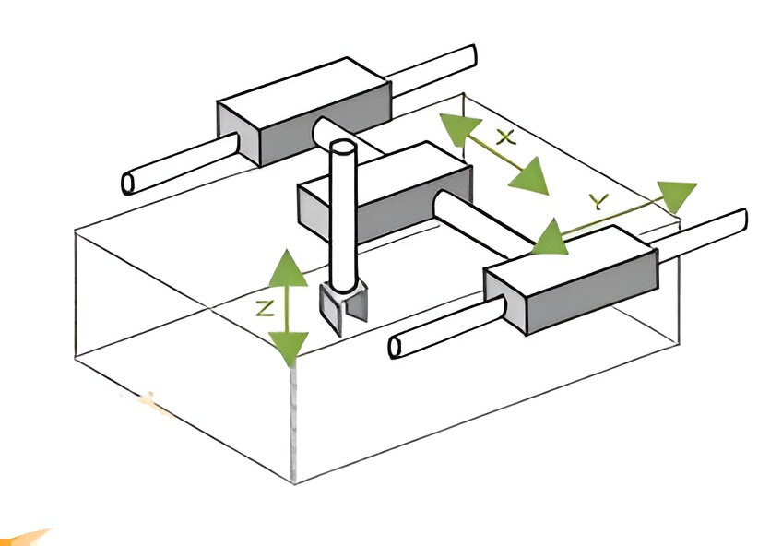
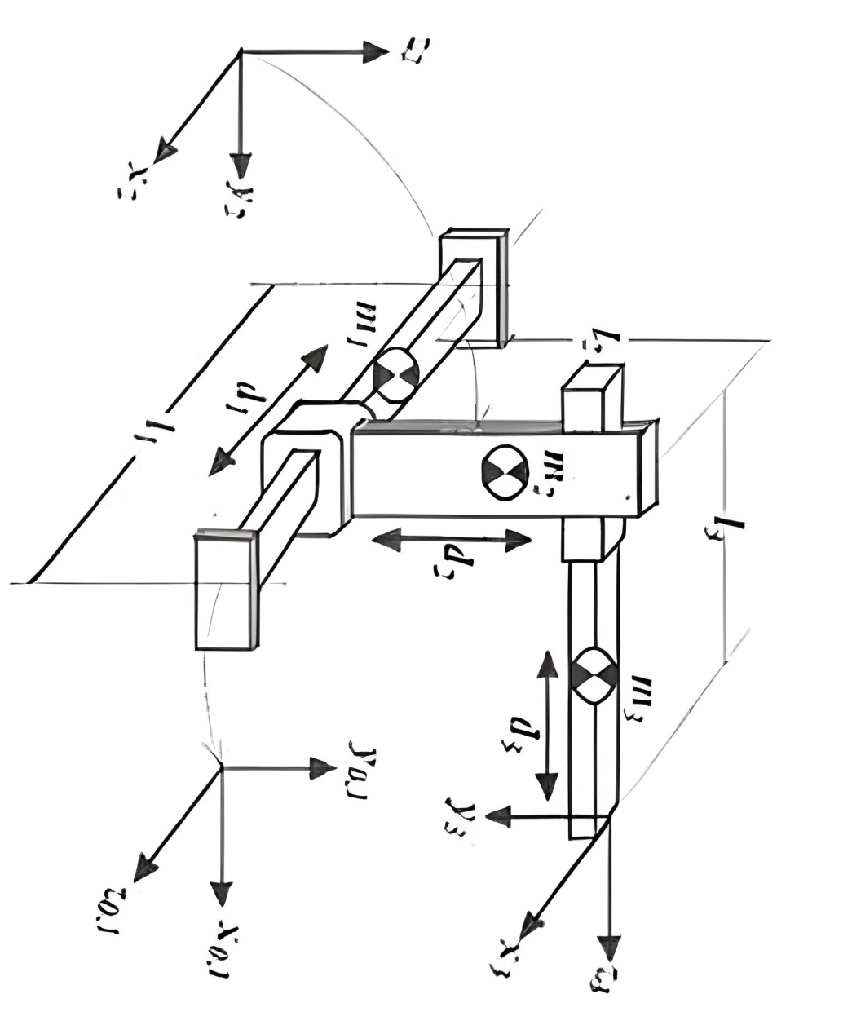
SCHEMATIC DIAGRAM

Slide 8
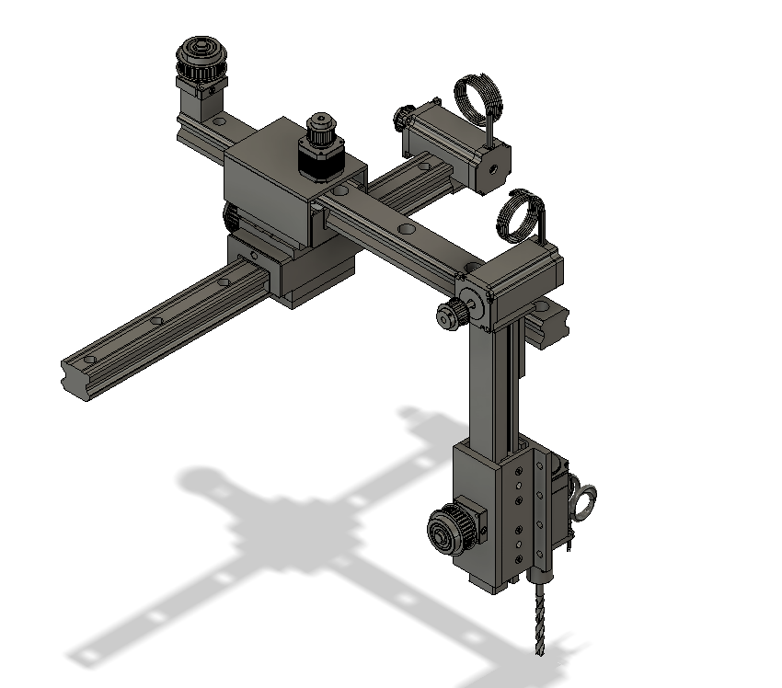
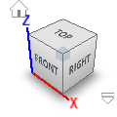
SYSTEM OVERVIEW

Slide 9
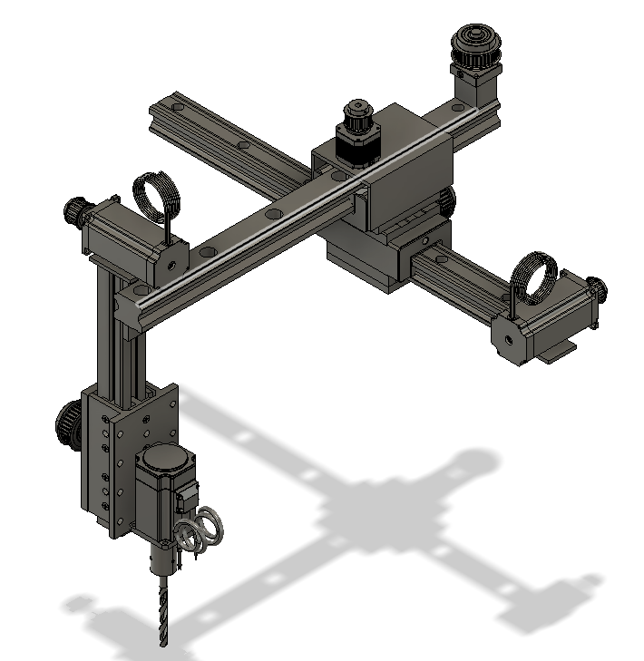
SYSTEM OVERVIEW

Slide 10
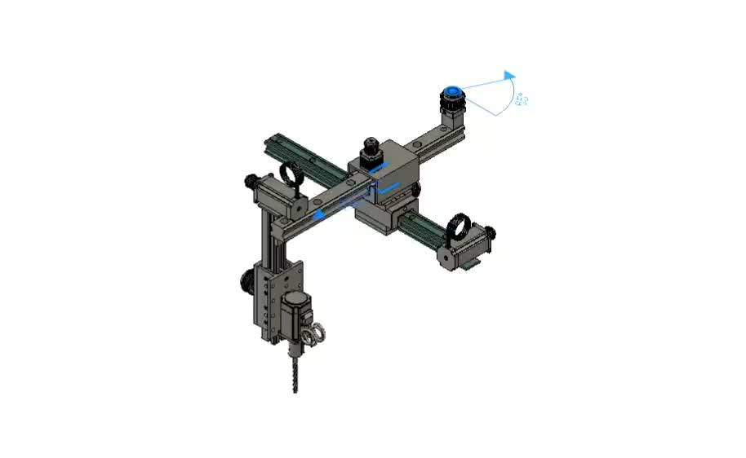
SYSTEM OVERVIEW

Slide 11
ADVANTAGES
High precision and repeatability.
Reduction in labor costs and errors.
Programmable for various drilling tasks.

Slide 12
CONCLUSION
The automated drilling robot enhances manufacturing efficiency and precision.
It integrates mechanical design, automation, and control systems.
Future improvements include AI-based path optimization and adaptive control.

Slide 13
THANK YOU

